Slide 1
Lending Club Case Study
July 5, 2023

Slide 2
Problem Statement
Analyse the data obtained from a consumer finance company and understand how Consumer Attributes and Loan Attributes influence the tendency to default

Slide 3
Understanding the problem
Cleaning Data
Analysing Data
Drawing Conclusions
Extract Data from csv
Identify and clean Null / NaN values
Remove Columns to analysis
Format Data
Obtained Derived Data
We have taken multiple approaches to analyse the data
Identify relevant columns
Univariate analysis
Bivariate Analysis
Plotted relevant charts
Conclusions were drawn by comparing relevant consumer attributes identified and loan attributes, plotting relevant charts and cross checking observations.

Slide 4
Data Cleaning:
Multiple steps were taken to clean the data set obtained :

Slide 5
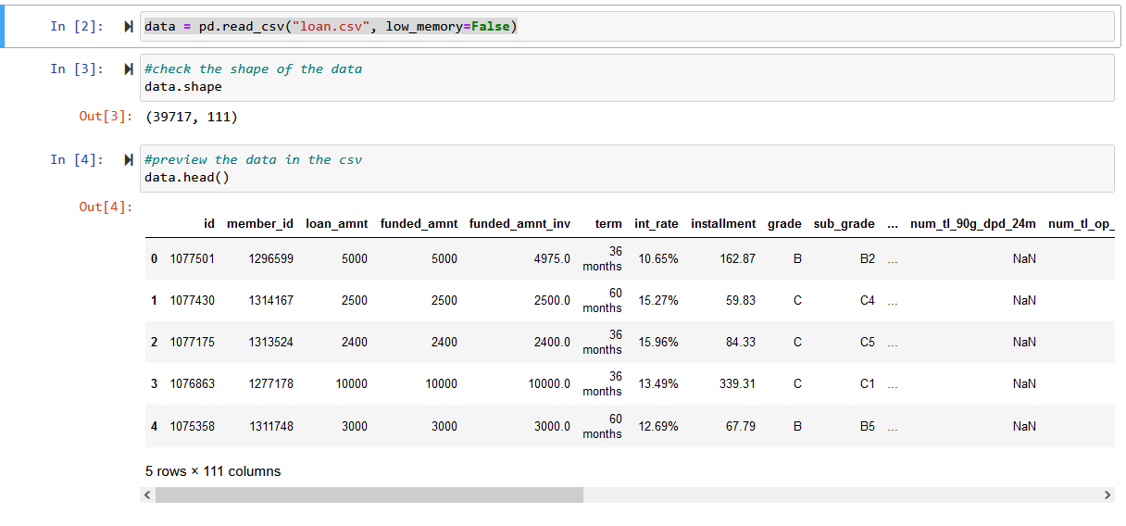
Checking current Dataset after import
Observed that the dataset contains 39717 rows and 111 columns.

Slide 6
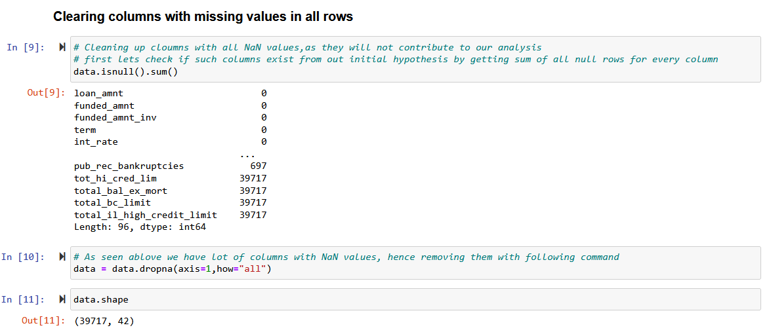
Check for column with all Nulls
Found multiple columns with No data (NaN) hence removed those columns

Slide 7
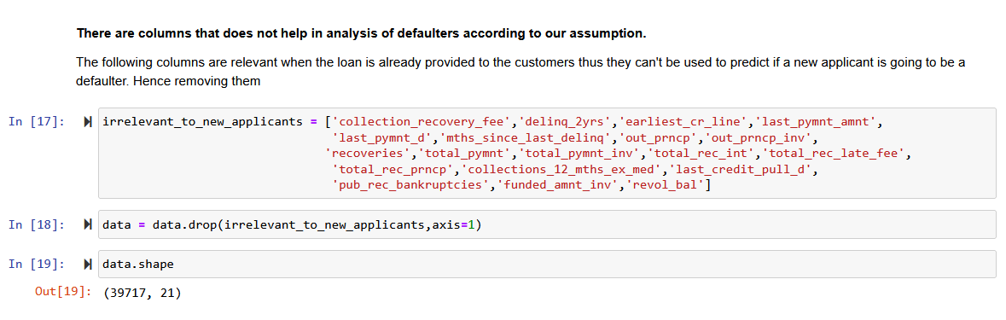
Identified and removed additional columns
We identified additional columns that do not contribute to our analysis in this phase and decided to remove them

Slide 8
Converting Columns to relevant Data types
Most columns were of type float64 or int64 , but a lot of columns were also object type
For the column “term” we striped the string at the end and converted to int32
For int_rate we removed “%” and converted to float64
Formatted date columns to Date time format and extracted year and month for future analysis
Excluded all entries with loan_status as Current for the analysis as we deemed it would be irrelevant for the situation
Segmented some columns according to requirements
Identified Outliers in columns and updated the dataset accordingly

Slide 9
Data Analysis:

Slide 10
Univariate Analysis

Slide 11
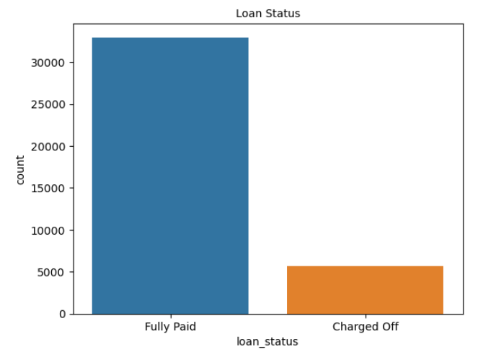
We Identified Loan Status as the target column in the data set as it tells us who fully paid the loans and those who haven’t

Slide 12
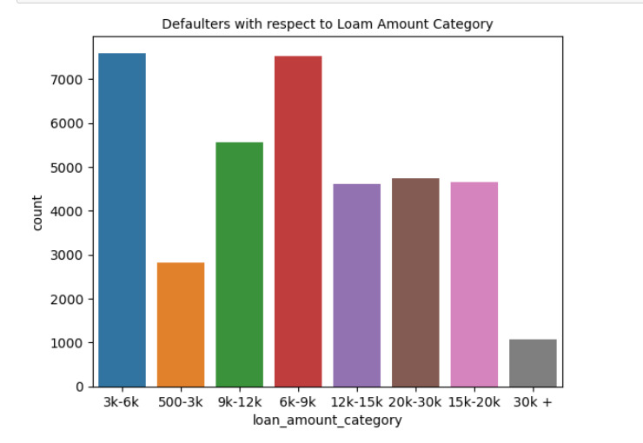
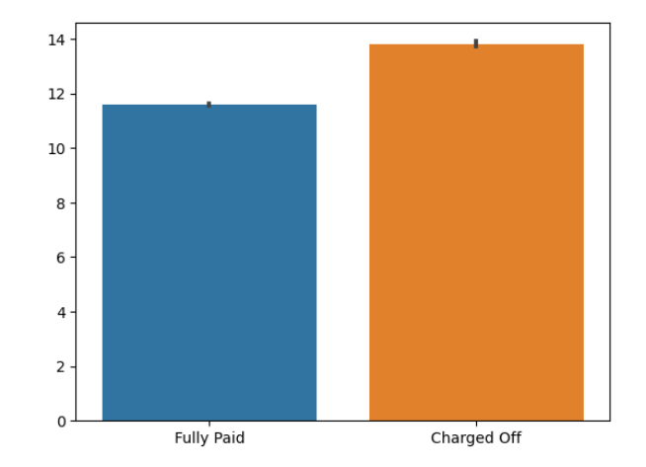
We plotted a bar chart to see the defaulters in each loan category
Around 7000 Defaulters when loan amount is between 3k-9k

Slide 13
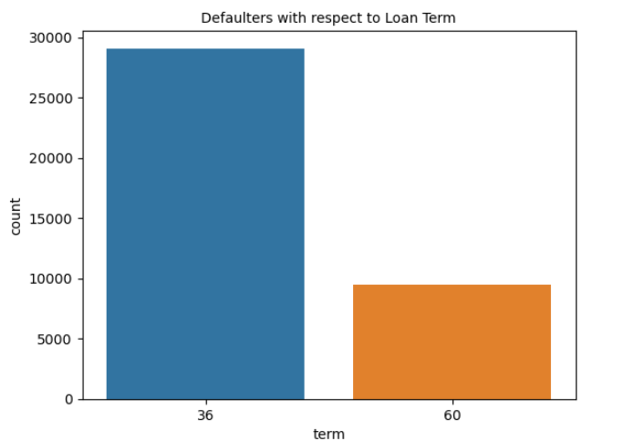
Defaulters with respect to loan term
Overall we see that defaulters count for 36 months term is almost three times to 60 months term

Slide 14
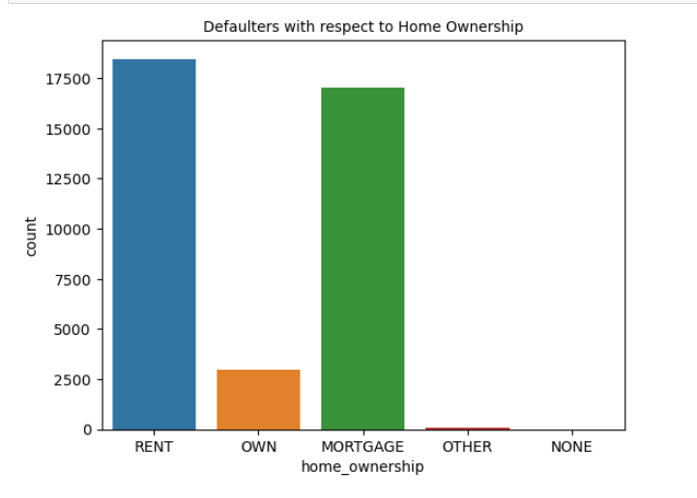
Defaulters with respect to home ownership
Customers who have home ownership as Rent and Mortgage tend to default more

Slide 15
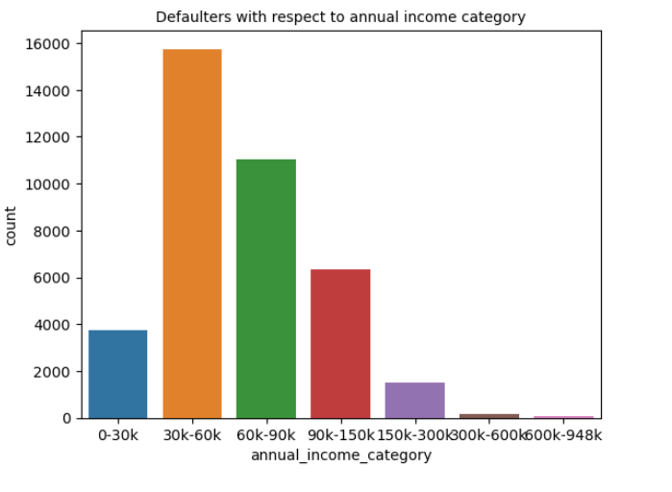
Defaulters with respect to annual income
While looking at the loan status with only Annual income range of 30k to 60k tend to default on their loan more

Slide 16
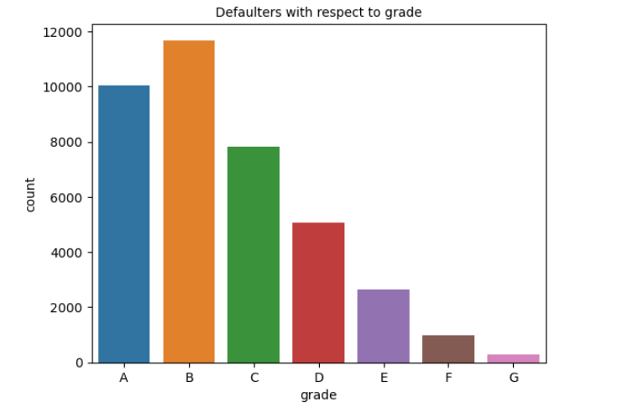
Defaulters with respect to Grade
Observed A, B and C have high number of defaulters, B being the highest

Slide 17
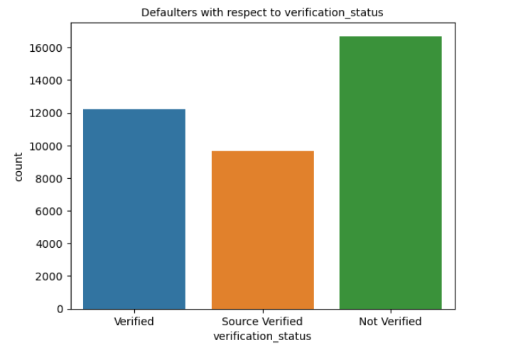
Defaulters with respect to verification status
Customers whose income was unverified seem to have high probability of defaulters.

Slide 18
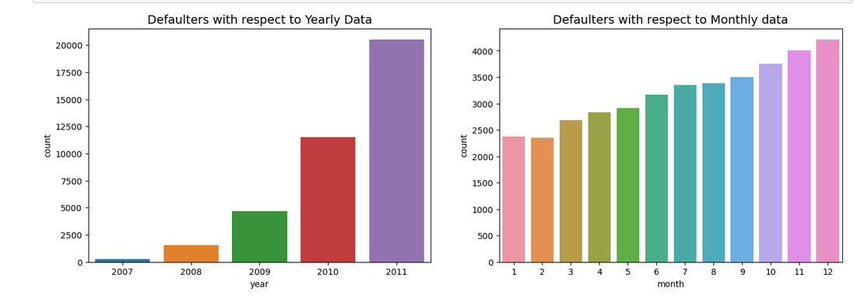
Defaulters with respect to Year and Month
Loans sanctioned in the year 2011 have highest number of defaulters. And the trend for months shows that loans sanctioned at backend of the year have relatively more defaulters, December being the highest

Slide 19
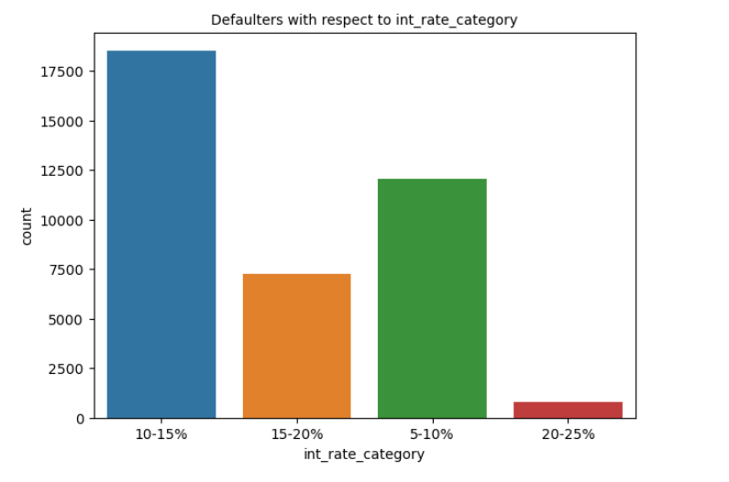
Defaulters with respect to interest rate category
Interest rate category of 10-15% have high chance of defaulting

Slide 20
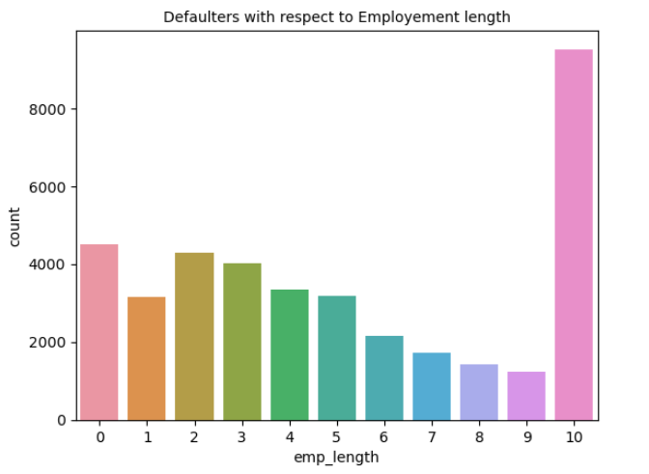
Defaulters with respect to Employment length
Customers with 10 years of experience tend to default more

Slide 21
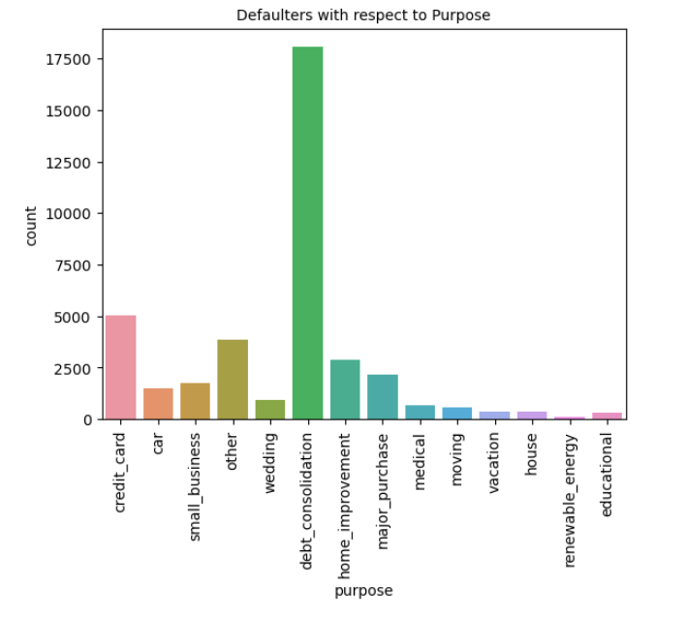
Defaulters with respect to Purpose
Loans taken for Debt consolidation, have high number of defaulters

Slide 22
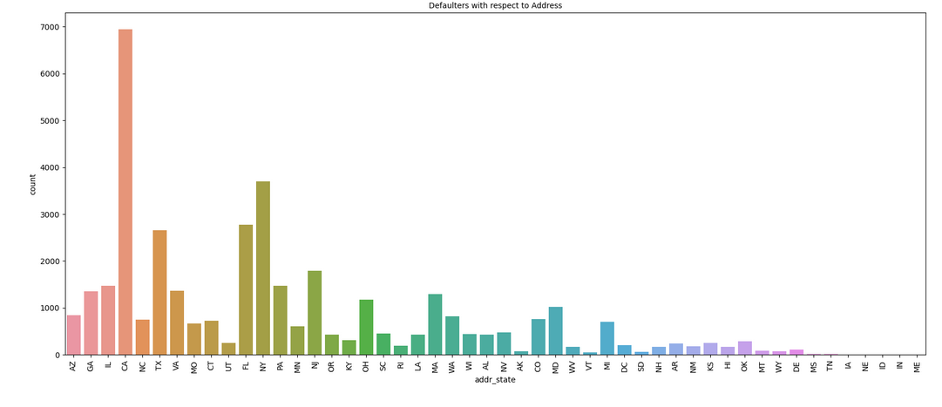
Defaulters with respect to state
States of CA, FL and NY seem to have greater than 3000 defaulters

Slide 23
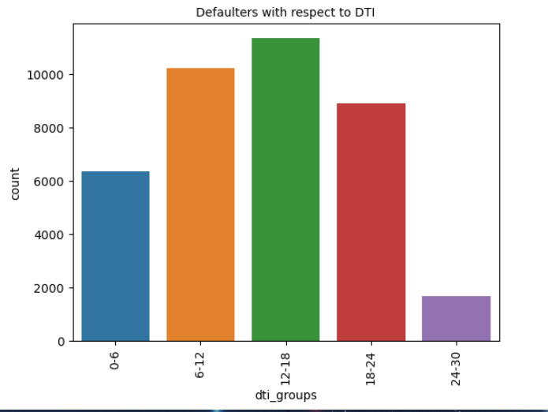
Defaulters with respect to DTI
DTI range of 12-18 have high probability of defaulters

Slide 24
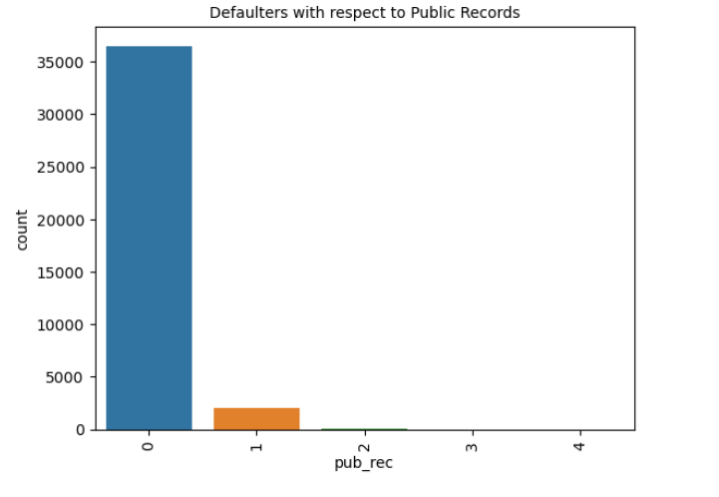
Defaulters with respect to public records
We can see that banks issue a lot of loans to people with 0 public records

Slide 25
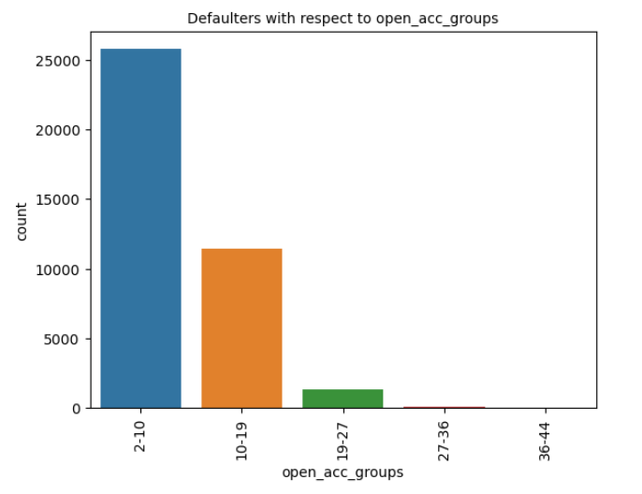
Defaulters with respect to open account groups
We can see that banks issue a lot of loans to people with 2-10 open credit line,

Slide 26
Univariate Observations
Default Indicators identified from univariate Analysis :
Loan_amount - 3-9K loan has highest defaulters
Term - Customers having 36 months have highest number of defaulters
Home Ownership - mortgage and rent are the highest defaulters
Annual income - 30-60k annual income range has high defaulters
Grade - Grade A, B and C have high number of defaulters
Verification status - Not verified customers had highest number of defaulters
Month - seen a trend where customers taking loans on December defaults more
Interest rate - Interest rate category of 10-15% have high chance of defaulting
Employment Length - Customers with 10 years of experience tend to default more
Purpose - Loans taken for Debt consolidation, have high number of defaulters
DTI - DTI range of 12-18 have high probability of defaulters
Address State - States of CA, FL and NY seem to have greater than 3000 defaulters
Public records - banks issue a lot of loans to people with 0 public records
Open account groups - banks issue a lot of loans to people with 2-10 open credit line
Defaulting Indicator 1
DTI range of 12-18 have high probability of defaulters
Defaulting Indicator 2
Defaulting Indicator 3

Slide 27
Bivariate Analysis

Slide 28
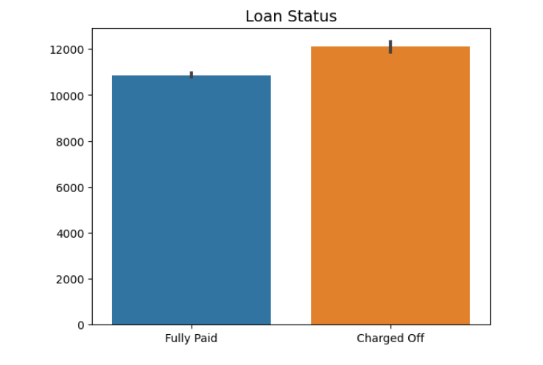
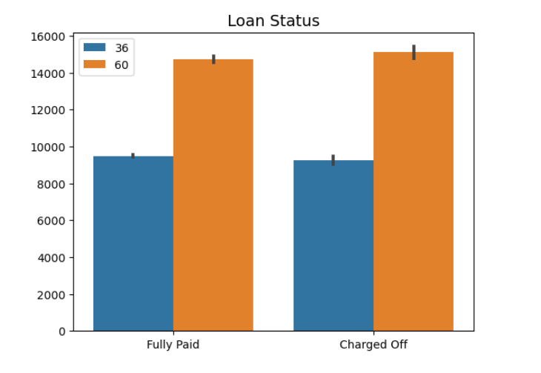
Loan status vs loan amount
Loan status vs funded amount
There is a high likelihood that if the loan amount is high the probability of defaulting is high for term of 60 months

Slide 29
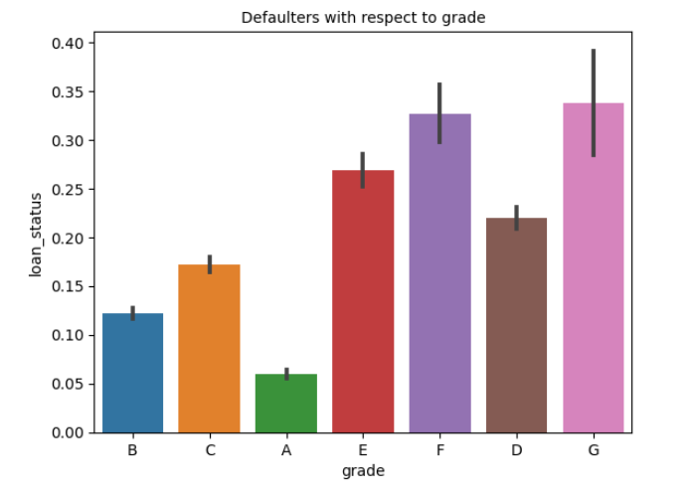
Defaulters with respect to grade
Loans with grade E,F,G seem to have high probability of defaulters.

Slide 30
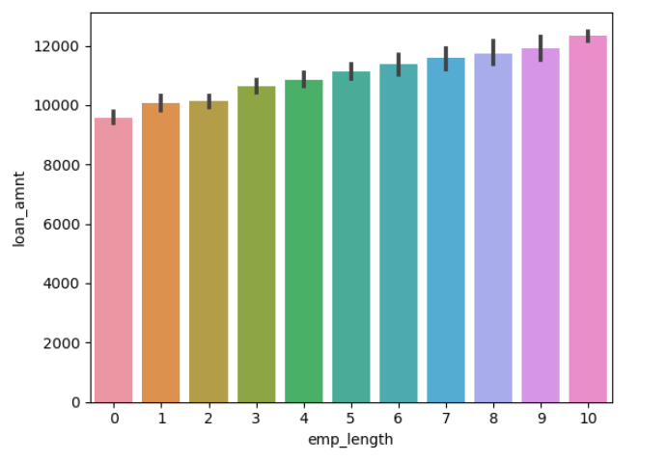
Loan amount vs employment length
We see that people with higher experience are sanctioned higher loan amount and there is a higher probability of them not paying it back

Slide 31
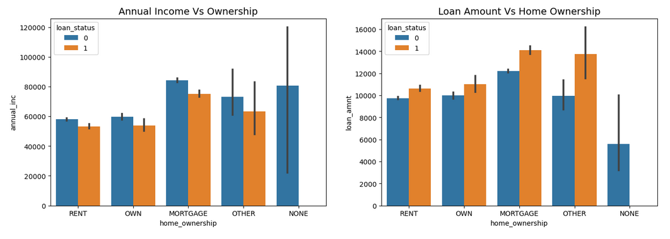
Home ownership vs Annual income category pt.1

Slide 32
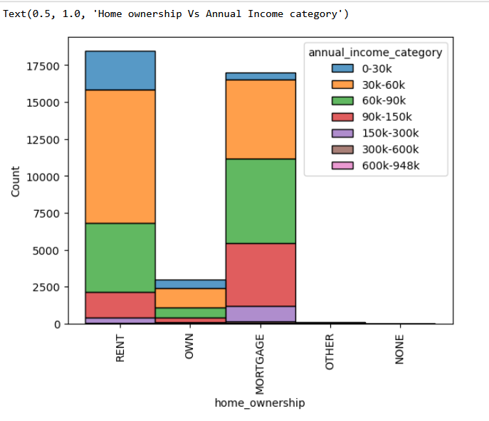
Home ownership vs Annual income category pt.2
Customers with home ownership as mortgage are defaulting more even if their annual income is high
Annual income category of customers with mortgage and rent have high number of defaulters is 30k-60k range.
Default Indicator : Home ownership type as Mortgage and Rent with Annual income range of 30k-60k

Slide 33
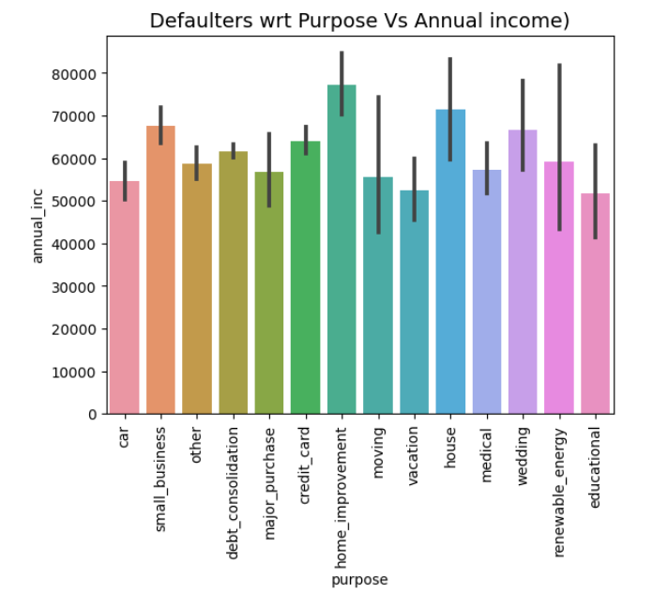
Defaulters with respect to Purpose and annual income
Default Indicator :Customer with annual income close to 80k and provide loan purpose as home improvement

Slide 34
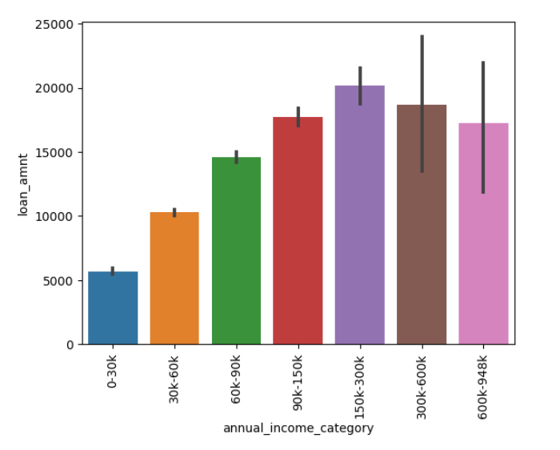
Loan amount Vs Annual Income Category
Default Indicator : Loan amount higher than 15k and annual income range between 150k-300k

Slide 35
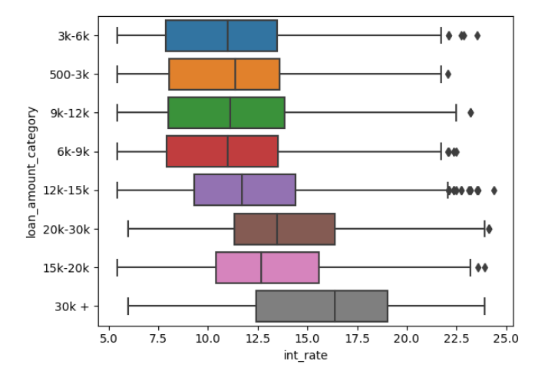
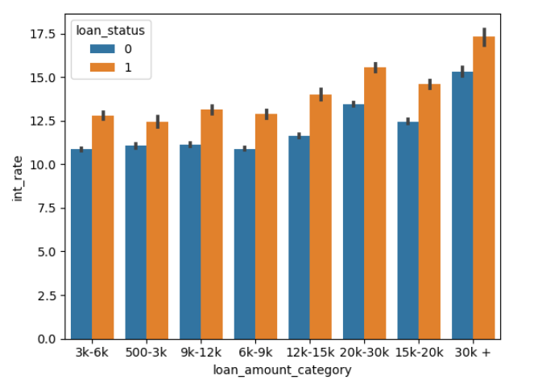
Loan amount category vs Interest rates
Default Indicator : Customers with loan amount more than 30k with rate of interest between 16-19%

Slide 36
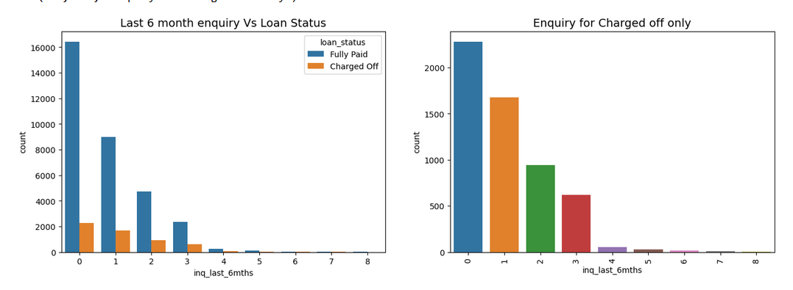
Default rate wrt inq_last_6mths
When enquiries in last 6 months were 6 and more then the chance of defaulting is around 25% or more. Hence inq_last_6_months is good indicator for defaulters

Slide 37
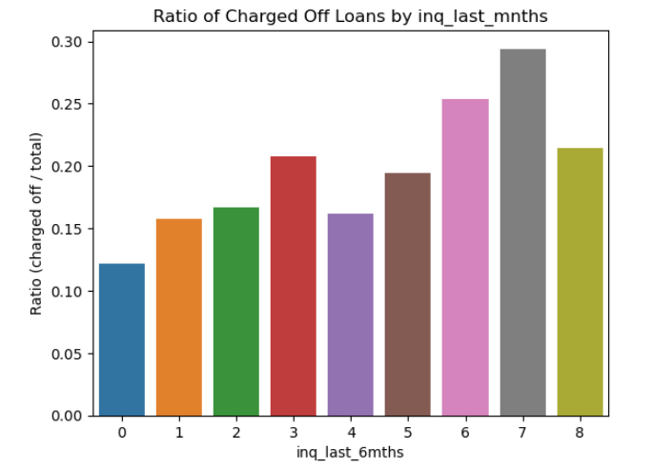
Charged off loans wrt inq_last_6mths
Observations :
When enquiries in last 6 months were 6 and more then the chance of defaulting is around 25% or more. Hence inq_last_6_months is good indicator for defaulters
Default Indicator : inq_last_6_months greater or equal to 6

Slide 38
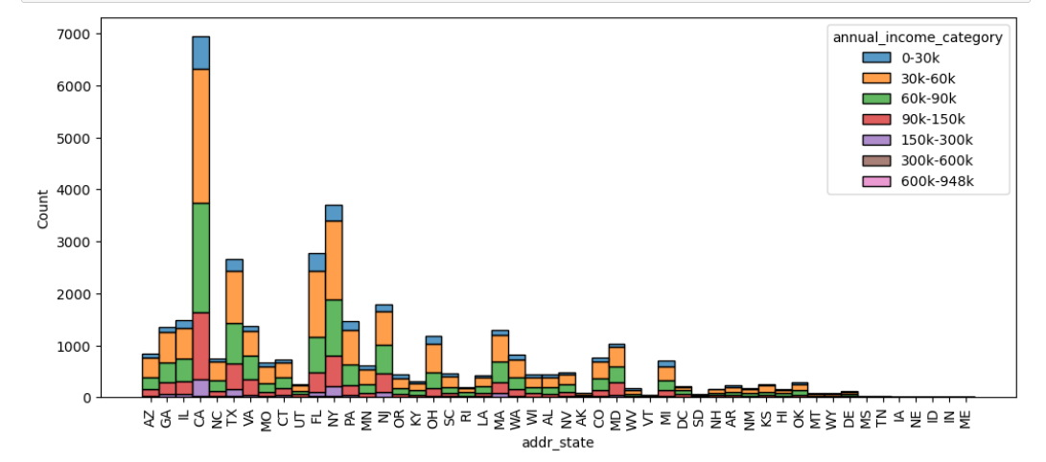
Address state with Annual income category
Bivariate analysis with annual_income_category show that 30k-60k is more in CA,FL and NA, which holds true wrt our previous analysis of defaulters in annual_income_category.

Slide 39
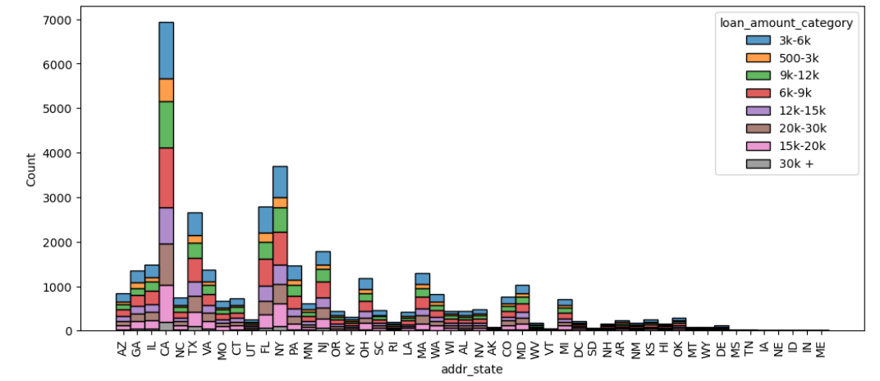
Address state with Loan amount category
Bivariate analysis with loan_amount_category show that 6k-9k is more in CA,FL and NA, which holds true wrt our previous analysis of defaulters in loan_amount_category
Default indicators: Applicants from States of CA, FL and NY with annual income between 30k-90k and Loan amount between 6K - 9K

Slide 40
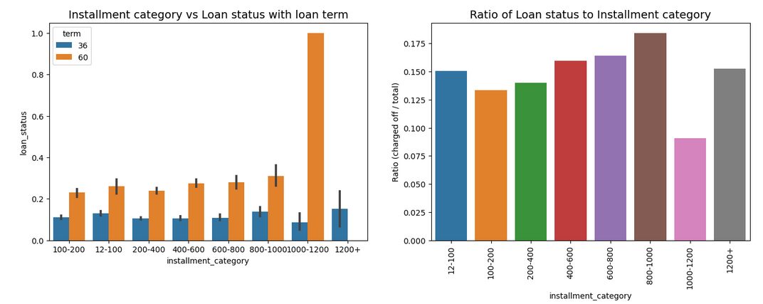
Analysis of Installment category , loan status , loan term
Default Indicator : Loan term=60 months and installment range 1000-1200

Slide 41
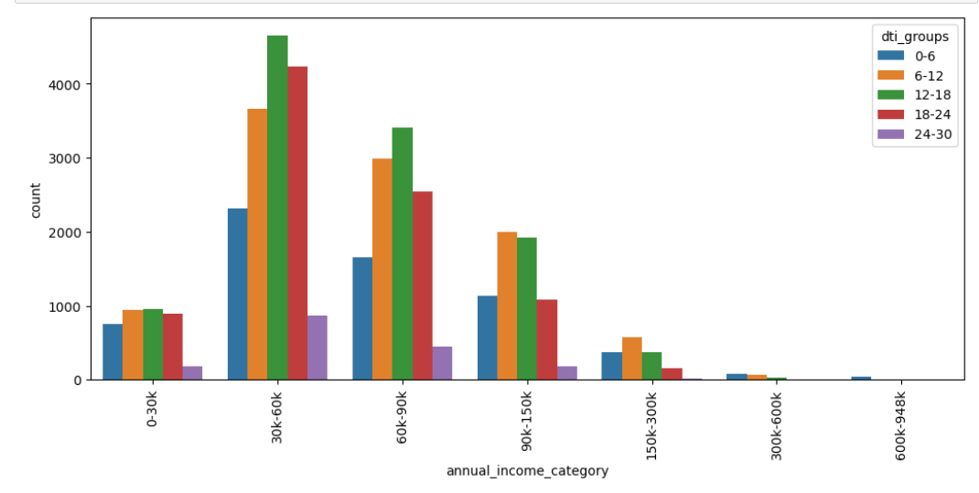
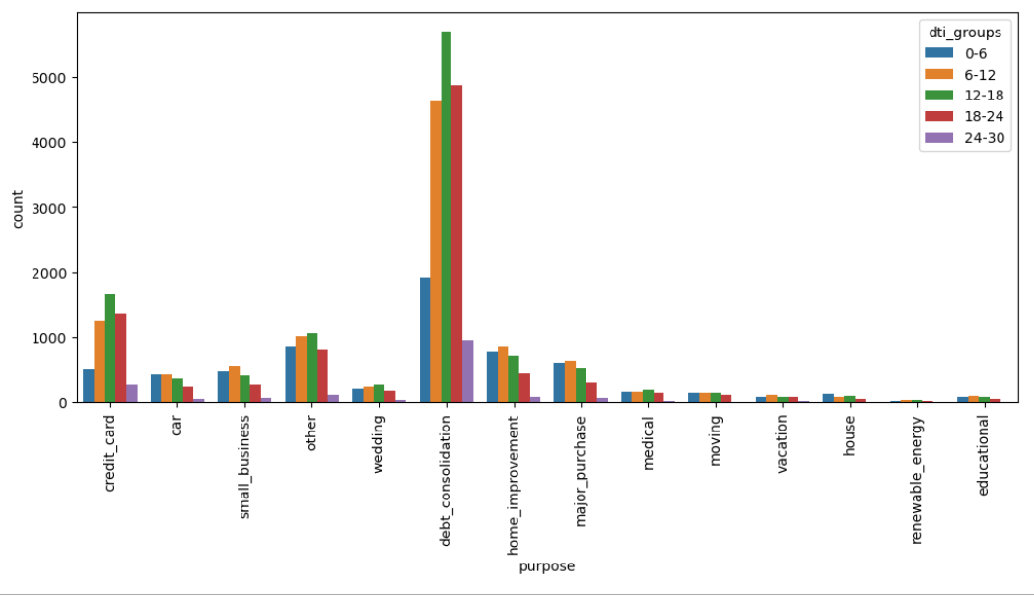
DTI analysis
Annual income between 30-60K and having DTI group between 12-18 have high defaulters
Default indicators : Purpose of debt consolidation and dti range of 12-18%

Slide 42
Bivariate Observations
Default Indicators identified from Bivariate Analysis :
Funded Amount : when the funded amount is more than 10k and the term is greater than 60 months
Grade : Plays a big factor, Loans with grade E,F,G are high risk
Employment length : when emp Length 10 years, loan amount granted 10k+
Home Ownership : type as Mortgage and Rent with Annual income range of 30k-60k
Purpose : annual income close to 80k and provide loan purpose as home improvement
Loan Amount & Annual Income : Loan amount higher than 15k and annual income range between 150k-300k
Interest Rate : Loan amount more than 30k with rate of interest between 16-19%
Inquiry for Loan : greater or equal to 6
Address State : Applicants from States of CA, FL and NY with annual income between 30k-90k and Loan amount between 6K - 9K
Installments : Loan term=60 months and installment range 1000-1200
Ownership and DTI : Installment category of 200-400 , home ownership type as rent and mortgage with dti range of 12-18%
Defaulting Indicator 1
DTI range of 12-18 have high probability of defaulters
Defaulting Indicator 2
Defaulting Indicator 3

Slide 43
CONCLUSION
On observing the trends from the data set obtained the following factors should be considered by the bank before approving loans :
If customer is having home ownership as renting or mortgage , and with the annual income in the range 30-60k , it can be a high risk profile
If customers purpose for loan is home improvement and annual income is around 80k, huge loans should not be approved
Longer term loans with installments of 1000-2000 is a high risk
Bank should reduce providing loans between 6K - 9K for the states for CA, NY and FL
Bank should discourage providing loans for lower grades
Banks issue a lot of loans to people with 0 public records and 2-10 open credit line , and which ideally indicate low risk, but according to the data have a high number of defaulters
Bank should discourage sanctioning Loan amount more than 30k with rate of interest between 16-19% as it shows high number of defaulters
Banks should discourage approval of loans if Inquiry for Loan in the last 6 months greater or equal to 6
If the DTI range of 12-24% we found that there is a high likelihood they are taking loan for debt consolidation , which increases risk

Slide 44


The Team
Mahalakshmi Totad
Vivek P Rajeev

